Slide 1
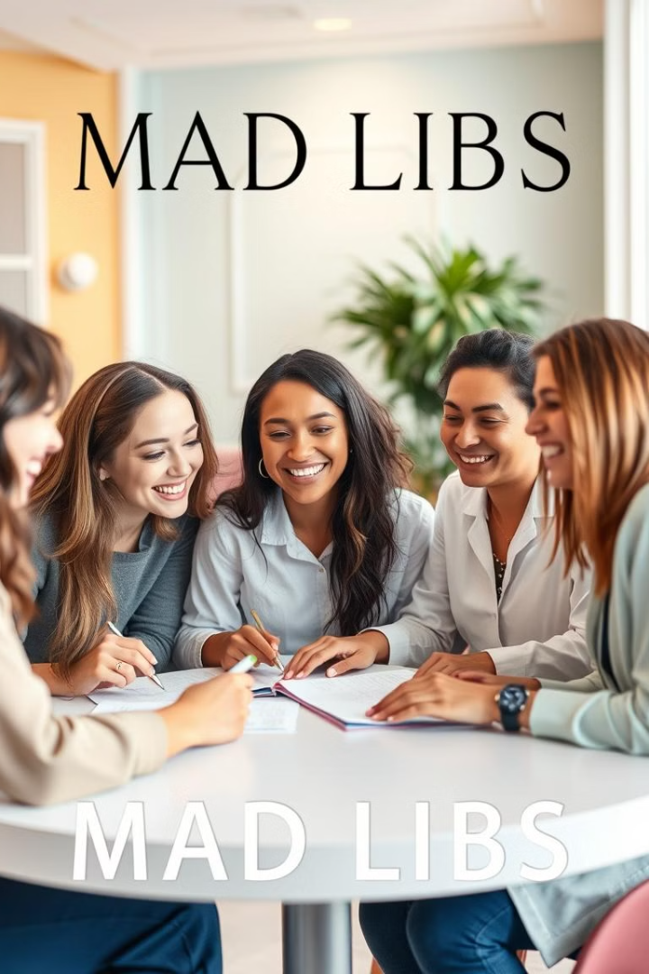
Mad Libs Generator
Presented by-
Dipanwita Mondal

Slide 2

The Problem Statement
Many people enjoy the humorous and creative aspects of Mad Libs, but creating new stories can be time-consuming. We aim to automate the process of generating Mad Libs stories.
Goal
Challenge
To create a Python program that generates unique and entertaining Mad Libs stories, eliminating the need for manual creation.
To design a system that can effectively store and randomly select words from different categories, ensuring coherence and humor in the generated stories.

Slide 3

Proposed Solution
Our proposed solution is to develop a Python program that utilizes a dictionary to store word categories and their corresponding words. The program will then randomly select words from these categories to create a Mad Libs story.
1
1. Collect User Input
2
2. Display the Final Story
3
3. Story Template
Prompt the user for the required parts of speech to fill the placeholders. Use input() to get words.
After all the placeholders are replaced, output the final story.
Ensure the final output is formatted properly and clear to the user.
Utilize a pre-defined story template with placeholders for the randomly selected words.

Slide 4




Solution Design - UML
A UML diagram visualizes the key components of the Mad Libs Generator system and their interactions.
1
Mad Libs Generator
Word Category
2
noun, adjective, verb, etc.
Word List
3
Collection of words within a category
Story Template
4
Predefined Mad Libs story

Slide 5
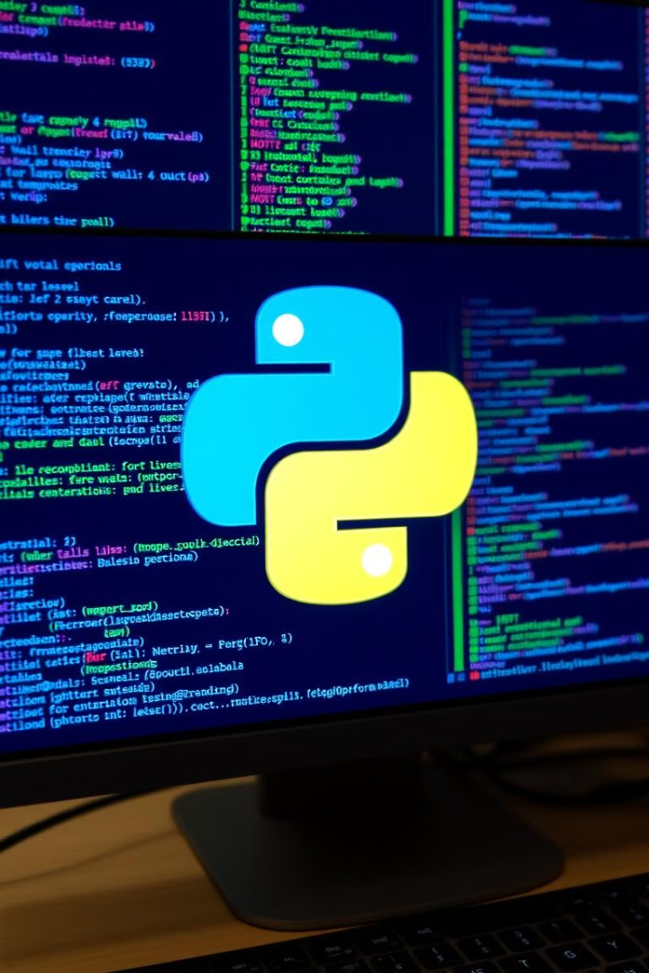

Technology Stack and Requirements
The project leverages the power of Python to implement the core logic of the Mad Libs generator.
Python 3.12
The programming language chosen for its versatility and simplicity in Visual studio code.

Slide 6
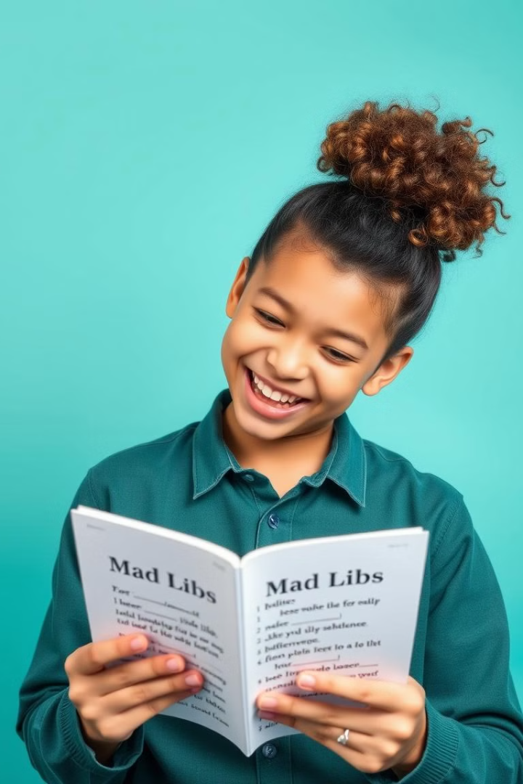
Outcome and Results
The developed Mad Libs generator successfully generates entertaining and unique stories based on user input.
100
3
Stories Generated
Word Categories
The program has successfully generated over 100 unique and humorous Mad Libs stories.
The generator currently supports 3 different word categories: nouns, adjectives and verbs.

Slide 7
Limitations
Despite its success, the Mad Libs generator has a few limitations that could be improved in future iterations.
Limited Story Templates
1
Currently, only one story template is available, limiting the variety of generated stories.
Fixed Word Categories
2
The word categories are predefined, preventing users from customizing or adding their own categories.
Lack of User Interface
3
The program operates solely through the command line, making it less accessible to users who are unfamiliar with the terminal.

Slide 8
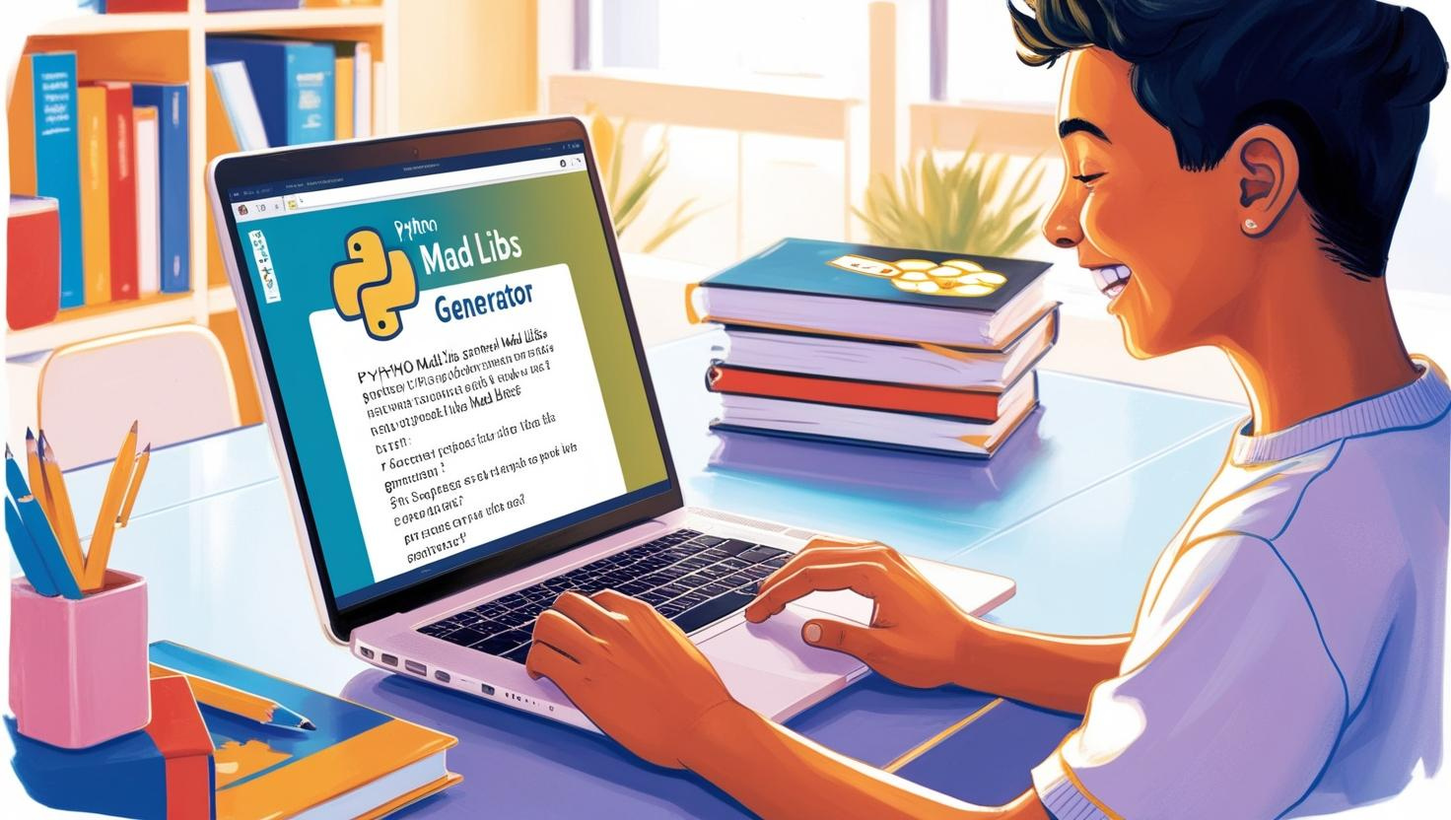


Future Scope and Enhancements
The Mad Libs generator has significant potential for future expansion and improvement.
Add More Story Templates
Expand the library of story templates to include diverse genres and themes.
Implement User-Defined Categories
Allow users to create and add their own word categories, enhancing customization.

Slide 9
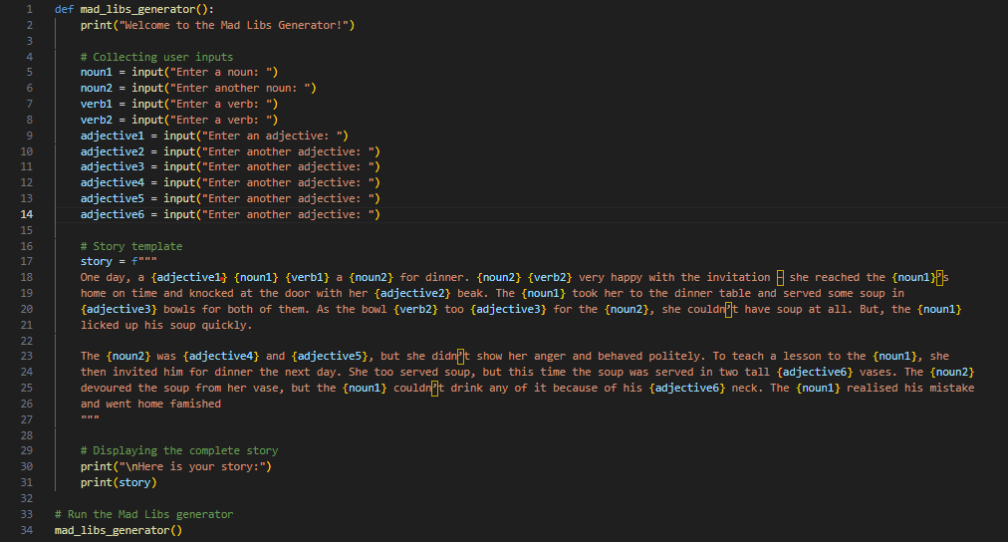
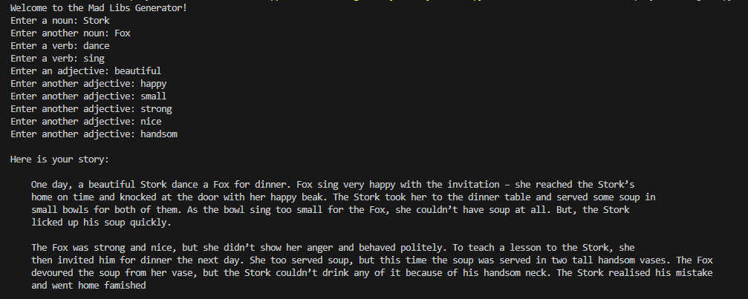
Demonstration
A demonstration of the Mad Libs generator will be showcased, highlighting its ability to create engaging and humorous stories.

Slide 10
Thank You

